Slide 1

Speaking engagement proposal
Prepared By SUE FEARLESS Founder of FEARLESS WOMEN

Slide 2
Partnering for Event Success
Any event planner knows that providing quality content is critical to a successful event and is also crucial for receiving a positive audience response. Many organizations rely on external speakers to complement in-house expertise and add credibility and value to events. There are several reasons why hiring an external speaker for your event can be advantageous.
Speakers can provide:
Knowledge – a speaker with specific subject matter expertise can provide essential insights on industry trends and best practices to your audience.
Inspiration – a speaker can offer a high-energy, thought-provoking or motivational speech to encourage your audience to adopt new concepts or conquer new challenges.
Visibility – a recognized speaker can be an asset to your agenda, increase event attendance and attract media interest.
SUE FEARLESS and FEARLESS WOMEN have provided event presentations on key topics for over 4 years. Sue Fearless has presented at over 40 College, Corporate, Entrepreneurship and Motivational events. Our experience has taught us that close collaboration with clients allows us to align our expertise with client goals and objectives to ensure the best audience experience possible. As a result, we partner with you before, during and after the event to ensure a fantastic venture for all involved.

Slide 3

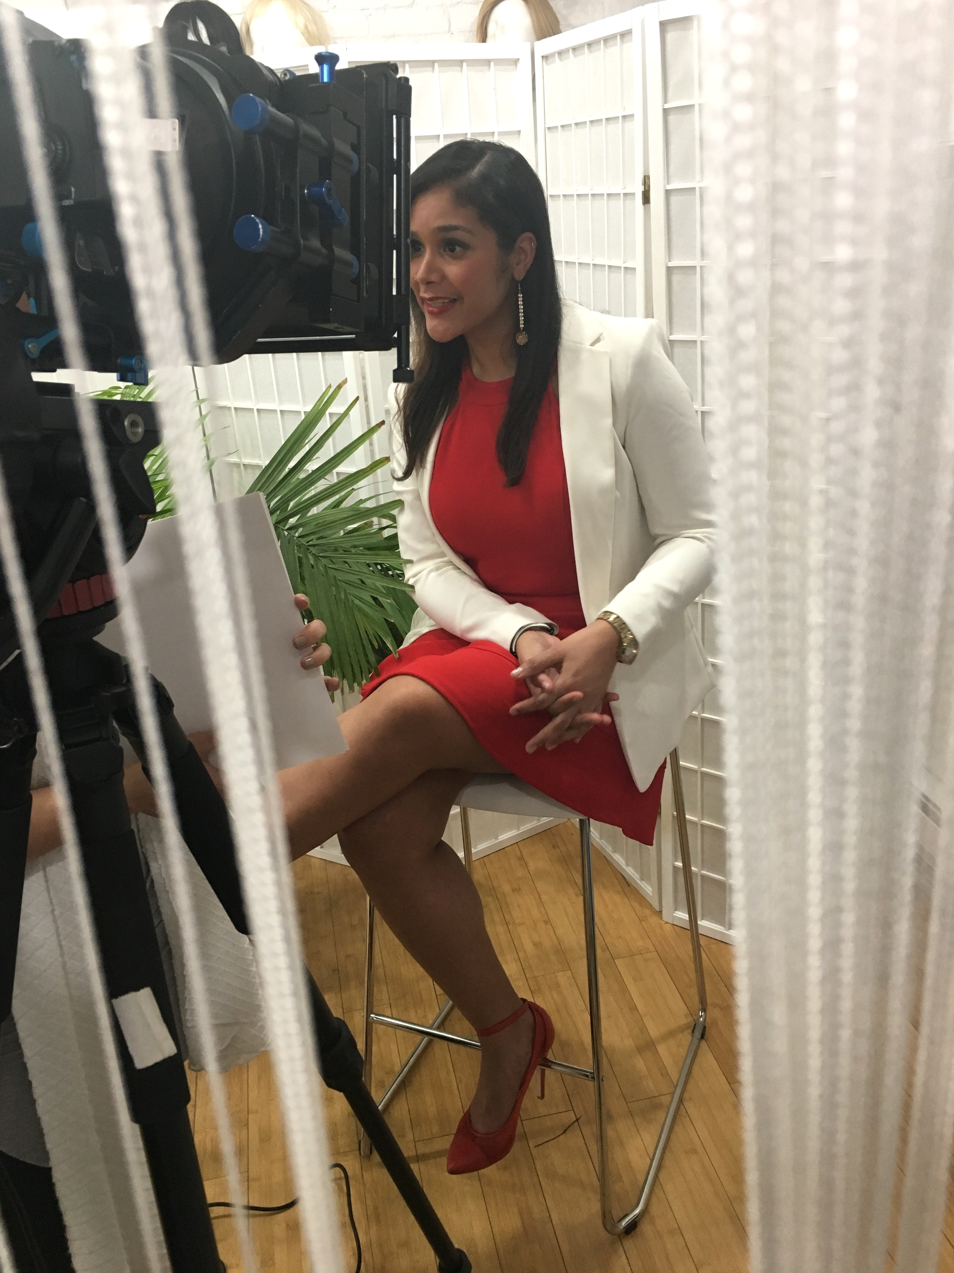
Areas of Speaking Experience:
* Mindset Coaching * Health and Wellness * Personal/Professional Development * Career coaching * Marketing * Business 101 * Networking * Entrepreneurship * Motivational Speaking * Youth Education * Trauma and Abuse Sessions
With my non-profit organization, Fearless Women, whose mission is to provide the resources needed to Heal, develop a Healthy Positive Mindset and take back control of your life through
Health & Wellness sessions, Group & Individual workshops, Sisterhood gatherings and Personal/Professional Development Corporate programs and Retreats. We work with
aspiring entrepreneurs, women who have battled abuse and women who have lost
motivation and who are looking for a second chance, Women in homeless shelters and
we coach and mentor our youth!
Motivational Speaker - I am hired throughout the Tri-state area and other major cities to
speak on panels, workshops, retreats and conferences on topics mentioned above.

Slide 4
Proposed Presentation
Based on our understanding of your organization and audience needs, our speaker will provide the presentation, outlined below, for your Speaking Opportunity which will be held on TBA.
Presentation Title: “Journey to Purpose”
Session Description: In this session I will be sharing the story on my personal journey to discovering my Purpose and how I overcame adversity, abuse, doubt, fear, depression and was able to maximize on the amazing opportunity that enrolling into Monroe College gave to me and how it help motivate and elevate my life.
Session Objectives: The objective of this session is to Motivate, Empower and Educate students on how to turn Pain into Purpose, Failure into Success and Fear into Fearlessness. I will be discussing ways to maximize on your opportunities, how to implement healthy daily patterns in your life, how to focus on reprograming your mindset, how to become Present in the moment, how to step into your Purpose, how to become the very best version of yourself and how to unlock your fullest potential.

Slide 5
Procedure
Pre-Event Preparation
To understand the needs of your audience and prepare relevant content, we will:
Send you a questionnaire to help understand event goals and audience needs
Attend pre-event phone call(s) with your event planning team to review event themes and align presentation content
Speak with audience participants to gain additional insights (if appropriate)
Sue Fearless will provide an initial draft of our speaker's presentation content on [TBA]. We will incorporate your feedback on our initial draft and send a final version on [TBA]. We will also provide a speaker bio by [TBA] for inclusion in your promotional materials.
At-Event Participation
Our speaker will deliver a presentation at your event on the scheduled date and time detailed in the “Event Overview” section. Our speaker will attend the event sessions you identify and network with your audience members. In addition, our speaker will attend any ancillary events – such as receptions and dinners at your request. We will discuss specific on-site expectations during our pre-event planning call(s).
Post-Event Review
Following your event, we will schedule a close-out call to review your perceptions of the event and also of our presentation. We ask that you supply any feedback you receive from audience members on our presentation. In addition, we will provide you insights gained from our speaker's discussions with your attendees that might be useful to you for business development or student/customer/employee retention purposes.

Slide 6
Event Overview
Key Event Facts
Based on our initial review of your requirements, we have discerned the following key facts about your planned event and our presentation:
Name of Event: TBA
Location of Event: Monroe College
Title of Our Presentation: “Journey To Purpose”
Date and Time of Presentation: TBA
In addition, if applicable, see below:
Room set up, Equipment, Laptop, High-speed Internet access Screen (freestanding or fixed), Microphone, Raised platform Display table for materials Others (TBD)
Any other needs will be identified in our pre-event planning discussions.

Slide 7
Terms and Conditions
Letter of Agreement
This agreement is between Sue Fearless, hereafter referred to as CLIENT, and (TBA), hereafter referred to as CONTRACTOR.
Description of Services (if applicable)
CONTRACTOR will:
Present a program titled “Journey To Purpose” for CLIENT’s event [TBA] on [TBA]. Customize the program, as needed, to fit the needs of the CLIENT.
Provide materials for attendees' use only. Materials are copyrighted, and unless specified in the materials or in writing, reproduction of any portion is prohibited.
Honorarium
CLIENT will provide CONTRACTOR an honorarium in the amount of $750, which will be paid according to the following schedule:
Deposit due: [TBA], 50% of agreed upon fee, due at time of agreement signing
Balance: [TBA], 50% due date of presentation
The pricing table below contains a detailed cost breakdown for each of our key areas of responsibility.

Slide 8
Cost Breakdown [If Applicable]
Expenses
Expenses for CONTRACTOR travel and other incidental items will be billed after the event and may include:
Air travel from [FROM LOCATION] to [TO LOCATION] (Coach class in North America, Business class internationally)
Ground transportation
Food and gratuities
Hotel accommodations (if required) shall be made by the CLIENT and billed to CLIENT at CLIENT business address.

Slide 9
Postponement or Cancellation
Once a presentation date is established, CONTRACTOR expends time and resources on CLIENT’s behalf. As a result, CONTRACTOR charges a cancellation fee to recover upfront expenditures and/or losses that may occur by not scheduling other business on CLIENT’s event date.
Should the presentation be postponed or cancelled for any reason, the following fee schedule shall apply:
Less than 30 days before event: 100% fee will be charged
Between 30 – 60 days before event: 50% fee will be charged
More than 60 days before event: no fee charged
Audio & Video Recording CLIENT may record all or part of CONTRACTOR’s presentation. Should CLIENT record the presentation, CONTRACTOR requires delivery of a master copy of the recording within 30 days after event close. CLIENT may distribute copies of our presentation to internal staff, but may not sell copies. Should CLIENT wish to make other recording or distribution arrangements, a separate agreement will be required.

Slide 10
Agreement Execution
To get started, simply review and accept this proposal online, print its PDF version, sign it, scan signed document and send to sue@fearless-women.com.
_______________________ _____________
Sue Fearless
Fearless Women
_______________________ _____________
[COMPANY.FirstName] [COMPANY.LastName]
Monroe College

Slide 11
Thank you
Sue Fearless
Founder/CEO - Fearless Women
Speaker | Mindset Coach | Educator | Advocate | Event Curator | Finance/Tax Consultant
Host of The Fearless Show on Bronxnet, MNN & DSN
Sue@Fearless-Women.com
347-577-9137
IG: @SueFearless @FearlessWomen @TheFearlessShow
Twitter: @fearlesswomenny @fearlessradio1
www.fearless-women.com & www.fearlessradioshow.com
Featured on Channel 12 News

